Slide 1
League of Legends Item Balancing Recommendations
Sebastian Alvis

Slide 2
Outline
Crash Course: League of Legends
Data
Statistics
Conclusions

Slide 3
Outline
Crash Course: League of Legends
Problem Statement
Data
Statistics
Conclusions

Slide 4
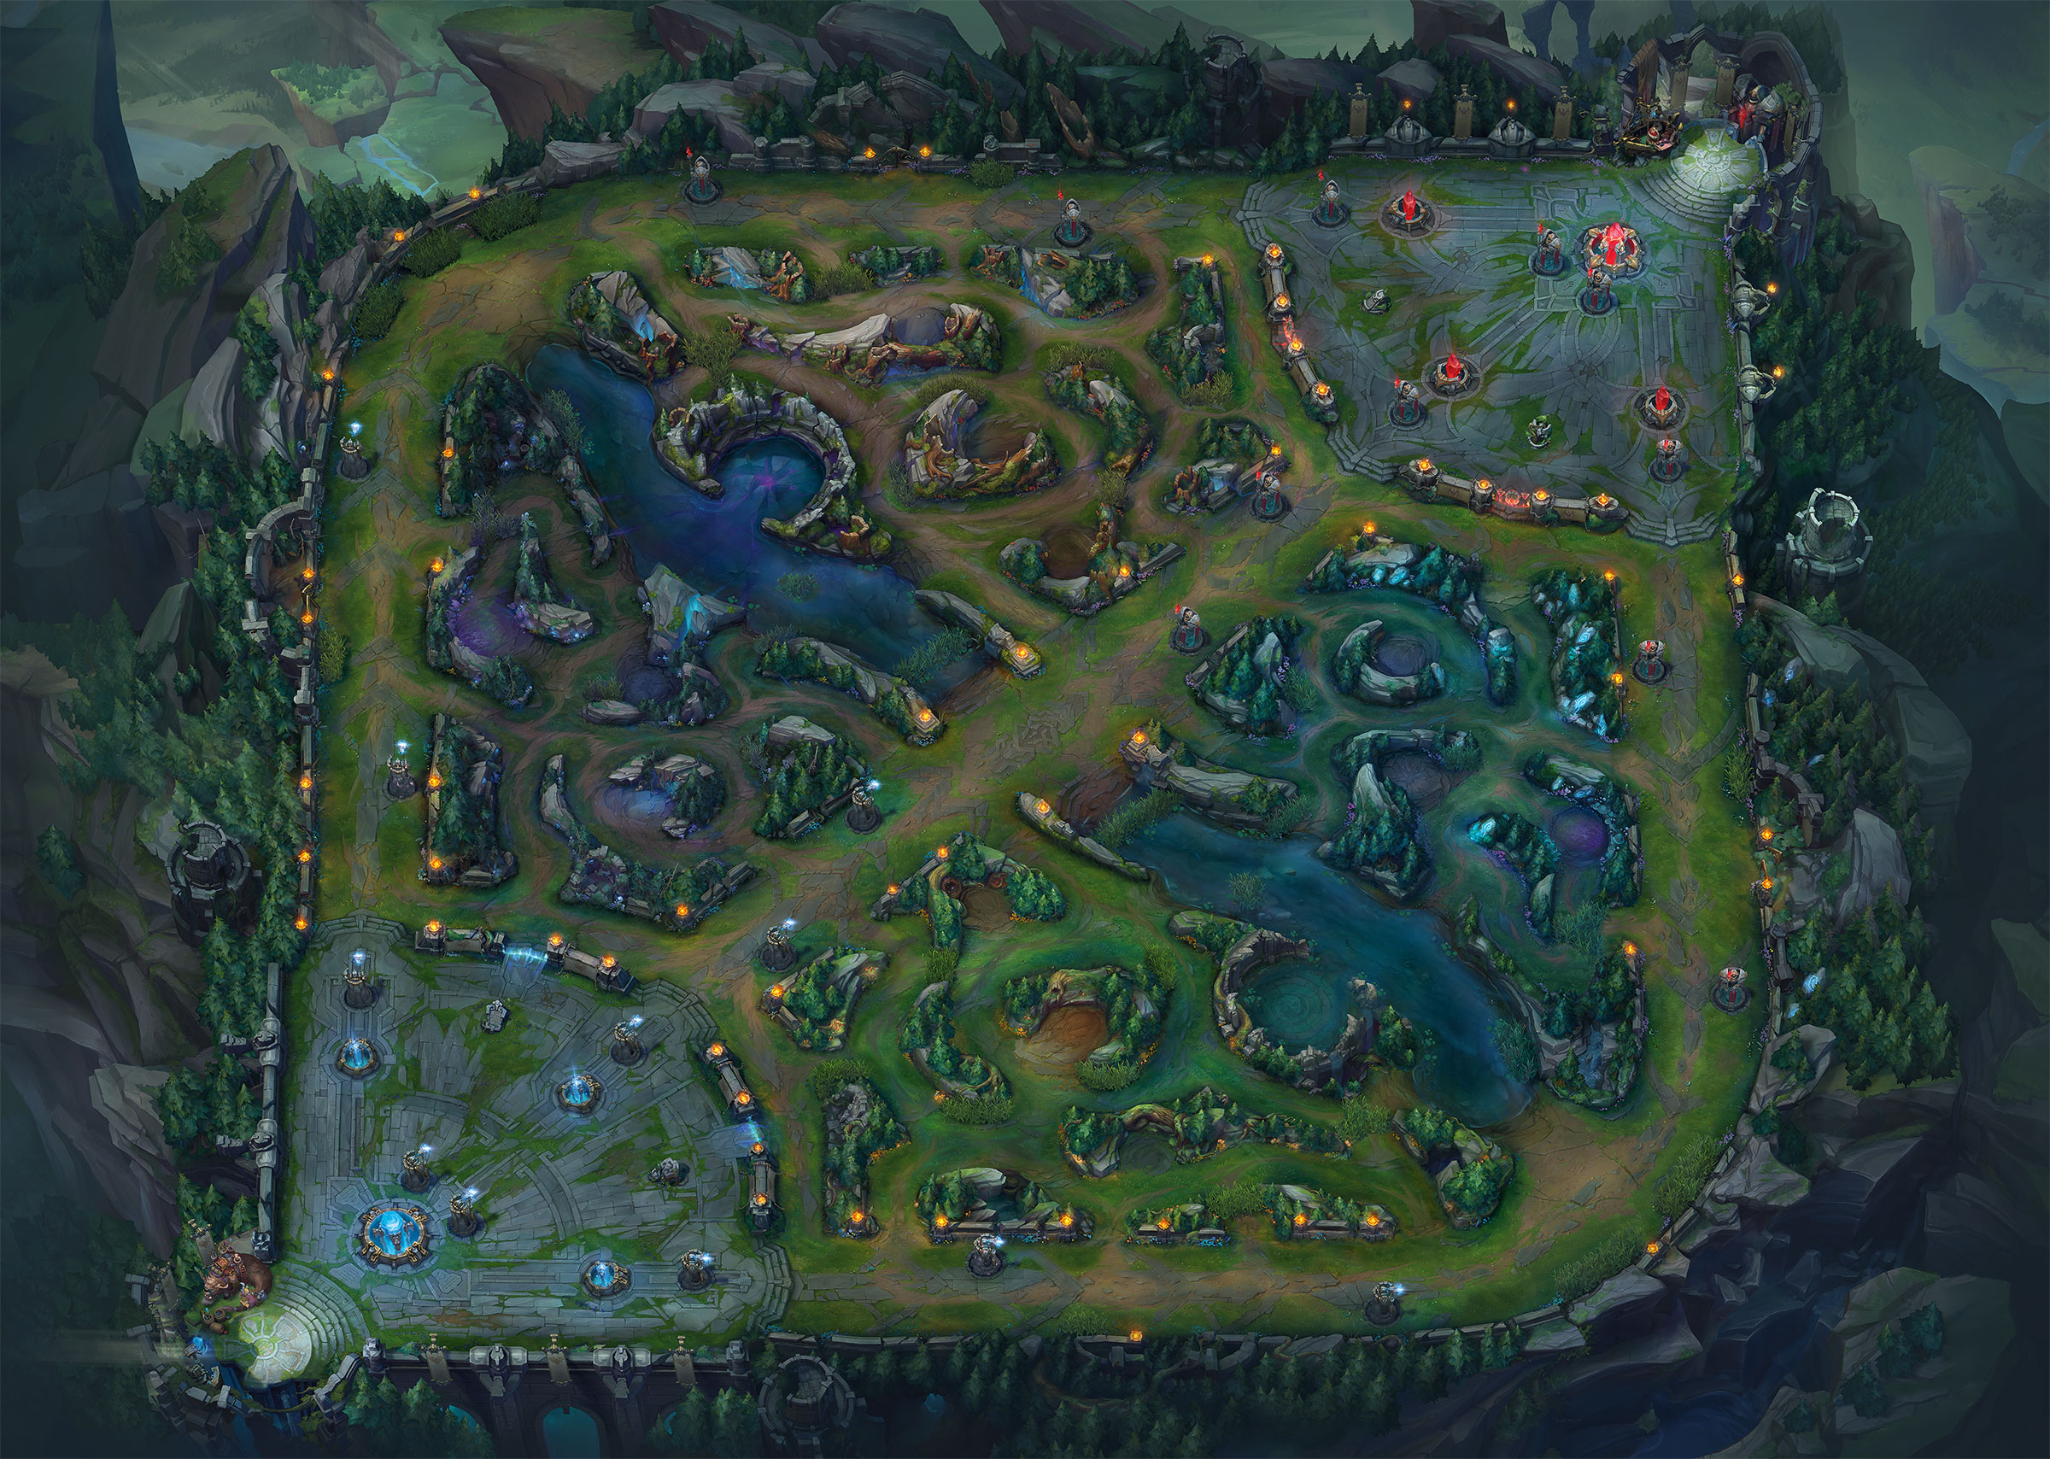
League of Legends: The Map
Summoner’s Rift
Both teams have bases
3 Lanes
Area between lanes is the Jungle
The River divides the map in half
Top Lane
Mid Lane
Bot Lane

Slide 5
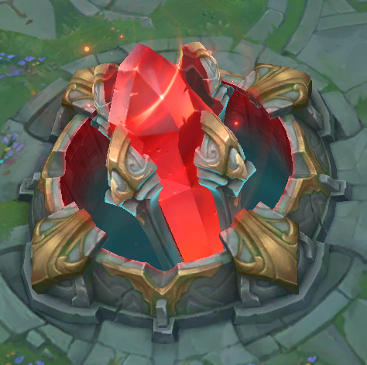
League of Legends: The Objective
Objective: Destroy the Nexus
Red Base Nexus
Blue Base Nexus

Slide 6

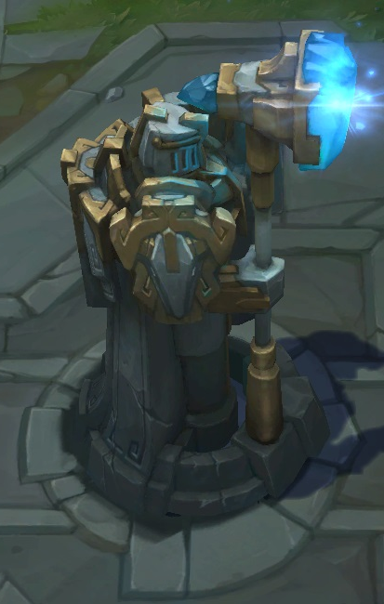
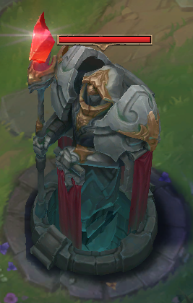
League of Legends: Towers
Towers block the lanes and shoot enemy champions and minions

Slide 7
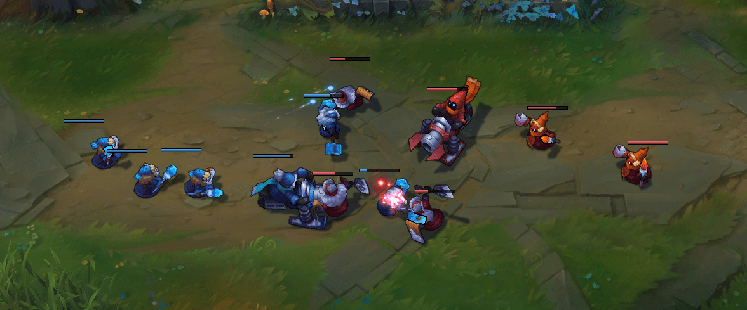
League of Legends: Minions
Objective: Destroy the Nexus
Lane Minions spawn in every lane to help get through structures
Red Base Nexus
Blue Base Nexus

Slide 8










League of Legends: Characters and Teams
Blue Team (Name/Role) | Position | Red Team (Name/Role)
Riven (Fighter) | Top Lane | Sion (Tank)
Jarvan IV (Tank) | Jungle | Sejuani (Tank)
Syndra (Mage) | Mid Lane | Lux (Mage)
Tristana (Marksman) | AD Carry (Bot Lane) | Twitch (Marksman)
Brand (Mage) | Support (Bot Lane) | Rakan (Support)
Starting Map Positions for players
Top, Mid, Bot, Support, Jungle
Maximize team gold
Various archetypes for champions
Assassin, Fighter, Mage, Marksman, Support, Tank
Archetype generally determines the kinds of items you buy

Slide 9
League of Legends: Laning
Objective: Destroy the Nexus
Players generally spend the first 15-20 min of the game in their lane

Slide 10
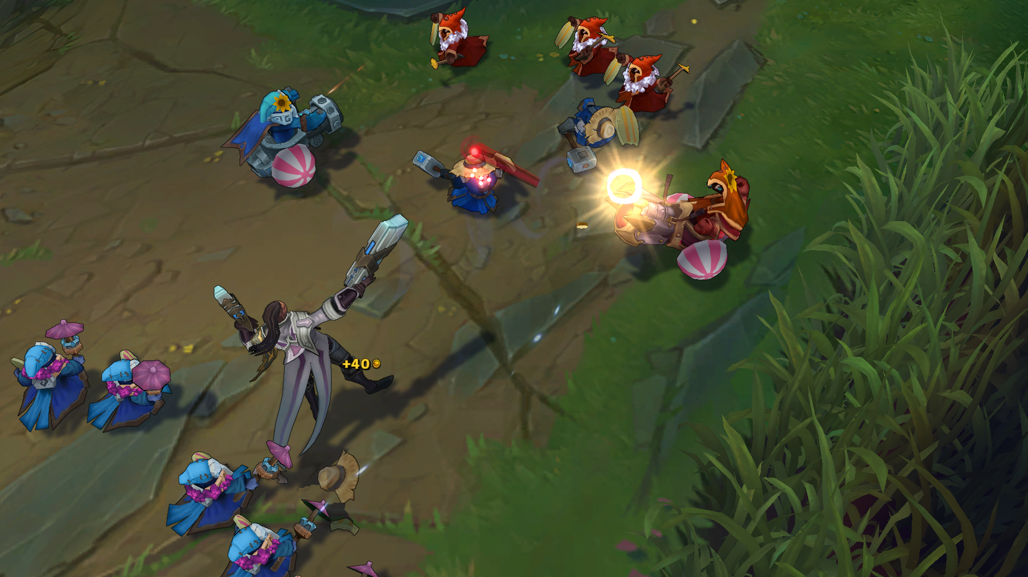
League of Legends: Laning
Objective: Destroy the Nexus
Players generally spend the first 15-20 min of the game in their lane
Kill enemy minions

Slide 11
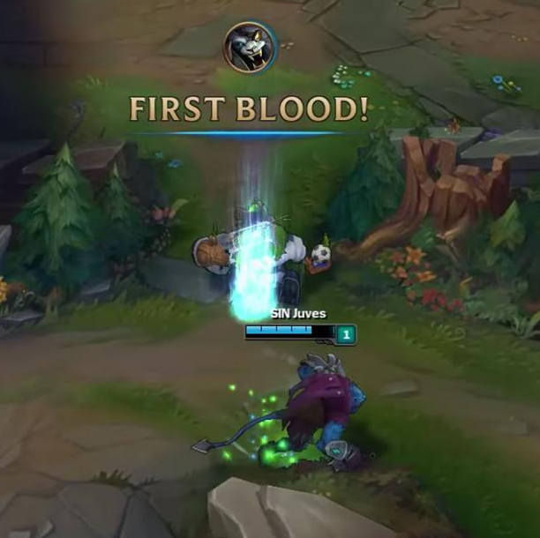
League of Legends: Laning
Objective: Destroy the Nexus
Players generally spend the first 15-20 min of the game in their lane
Kill enemy minions
Fight enemy champions

Slide 12
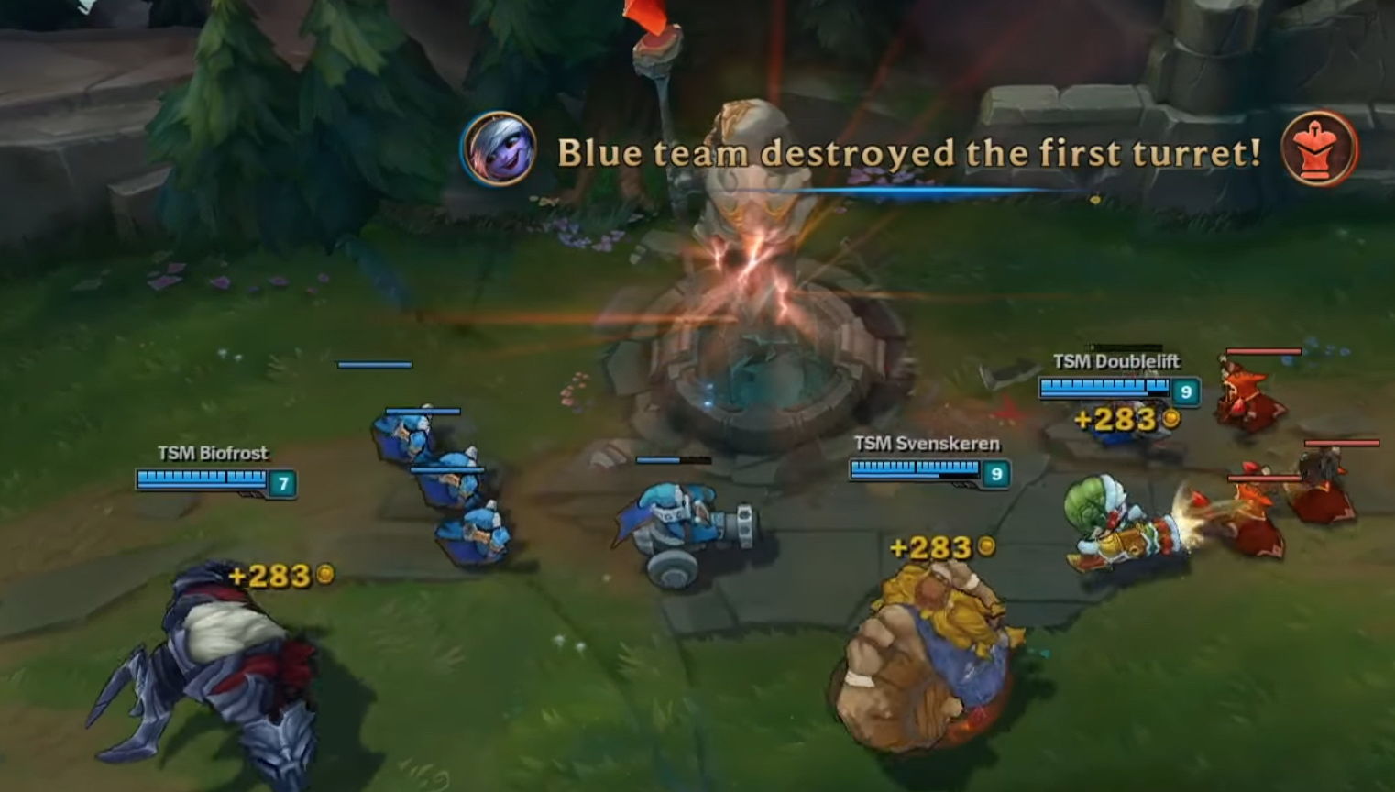
League of Legends: Laning
Objective: Destroy the Nexus
Players generally spend the first 15-20 min of the game in their lane
Kill enemy minions
Fight enemy champions
Destroy towers (if they can)

Slide 13
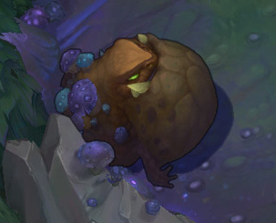
League of Legends: Laning
Objective: Destroy the Nexus
Players generally spend the first 15-20 min of the game in their lane
Kill enemy minions
Fight / kill enemy champions
Destroy towers
Kill jungle monsters

Slide 14
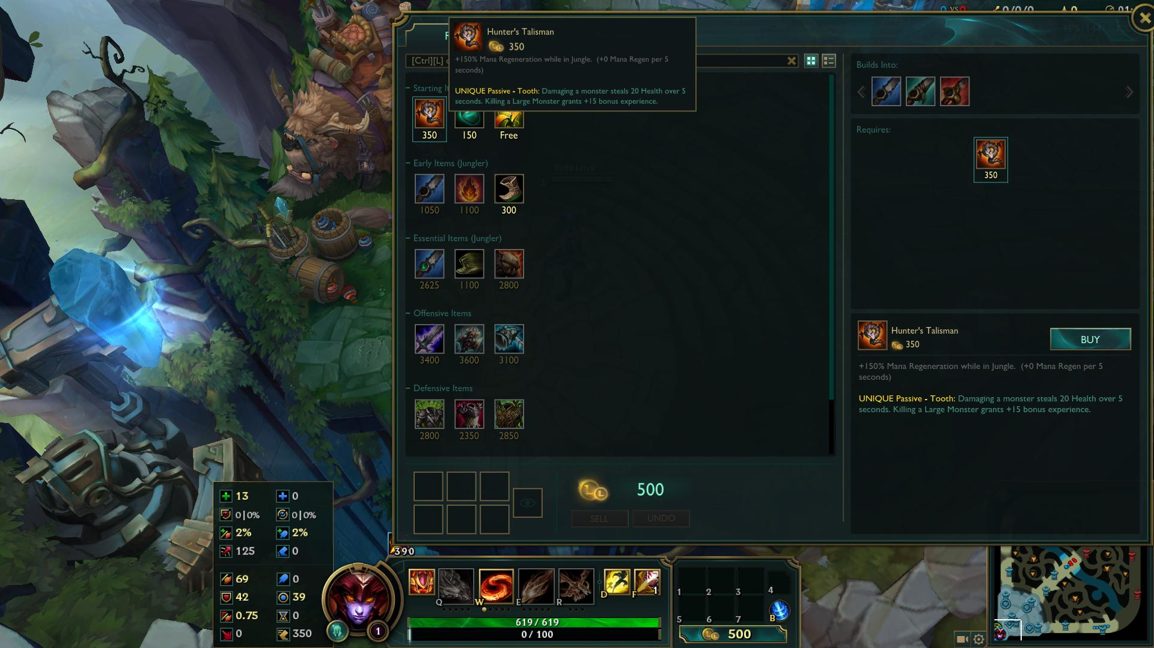
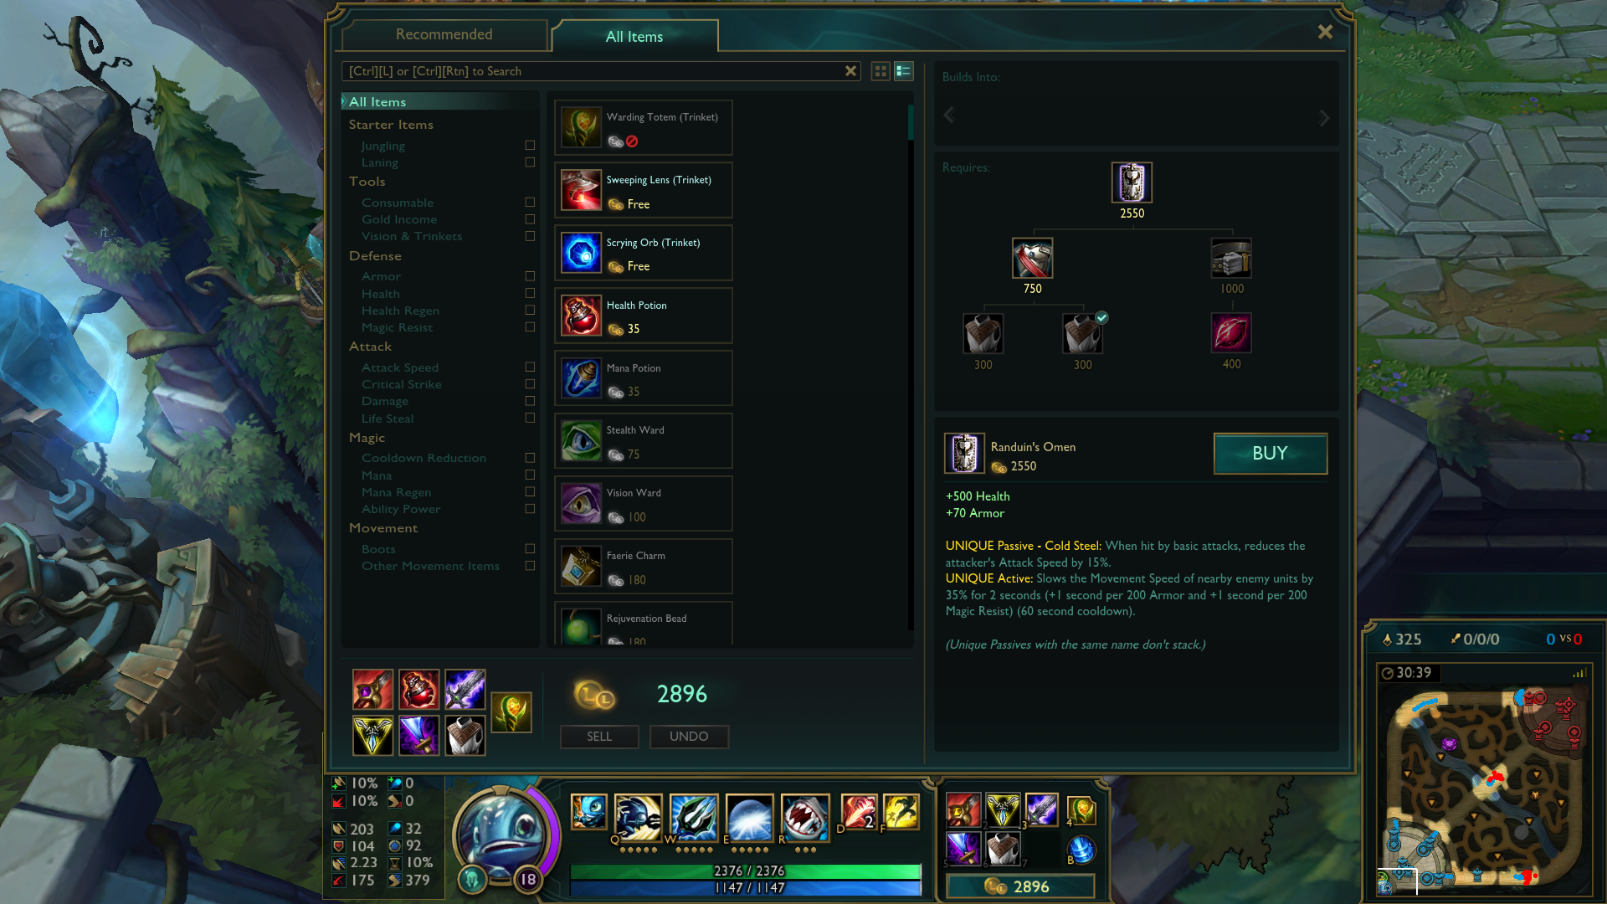
League of Legends: Money and Items
As players kill minions, champions, towers, and jungle monsters, they collect gold
Gold is spent on items, which upgrade various attributes of the champion
Items have a huge impact the game, and are one of the pillars of gameplay in LoL

Slide 15
Outline
Crash Course: League of Legends
Problem Statement
Data
Statistics
Conclusions

Slide 16
Why should you change items at all?
League of Legends currently has
141 champions
200+ items
Diversity is it’s strong suit as a game
Nobody wants to see the same set of champions and items every game
As a dev, you want to keep the game balanced so that lots of different champions and items show up
This makes the game more interesting

Slide 17
Problem Statement
As a developer, how do you know when you should change an item?

Slide 19
Dataframes
Matches
itemIDs, championIDs, item purchase times, win Boolean
Items
Item ID, name, tags, total gold
Champions
Champion ID, name, tags
Custom Item Dataframe
Item ID, # purchased in matches, pick rate, # wins with item, win rate, # unique champions that purchased item, total gold, tags

Slide 20
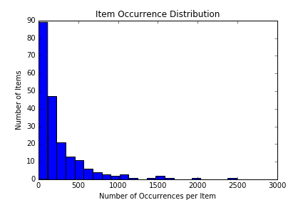
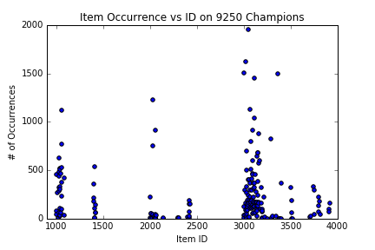
Item Occurrence
The highest 7 points around ID 3000 are wards and boots.
The high points around 2000 are refillable potion and control ward.
The high point around ID 1000 is Doran’s Blade.
Most full items are of ID > 3000

Slide 21
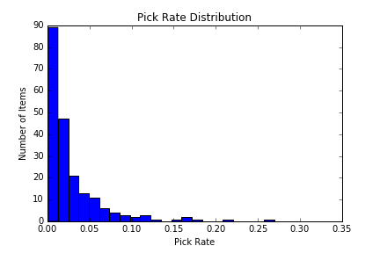
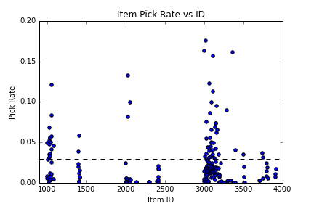
Item Pick Rate
Same distributions, but the numbers are now normalized

Slide 22
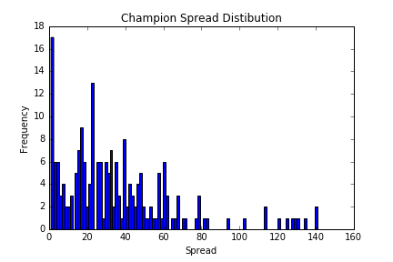
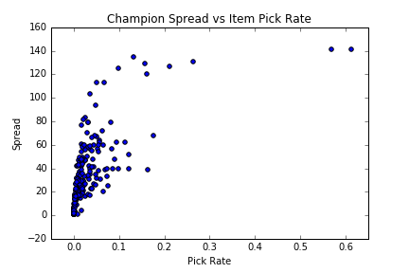
Champion Spread
How many unique champions does each item get built on?

Slide 23
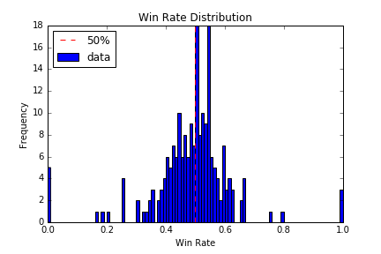
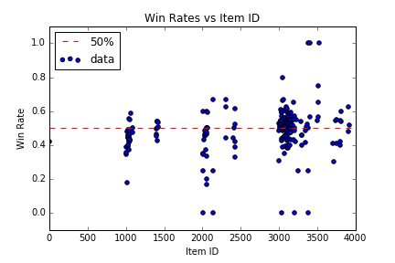
Win Rates
The probability that a player wins with a given item

Slide 24
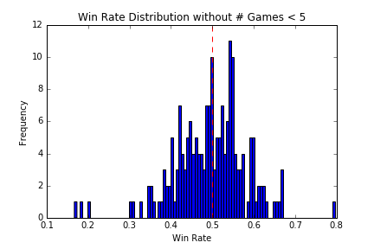
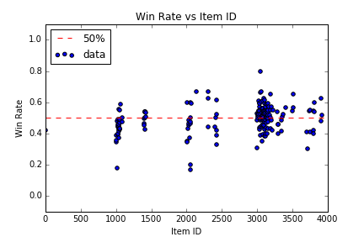
Win Rates (excluding items with < 5 games)
Removed items that had fewer than 5 games in my data

Slide 25
Correlations??

Slide 26
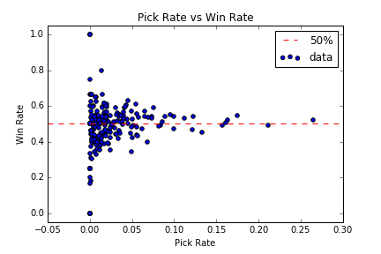
Pick Rate vs Win Rate
No Obvious correlation yet

Slide 27
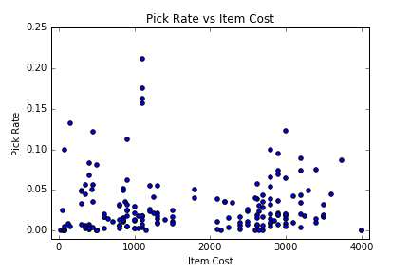
Pick Rate vs Item Cost

Slide 28
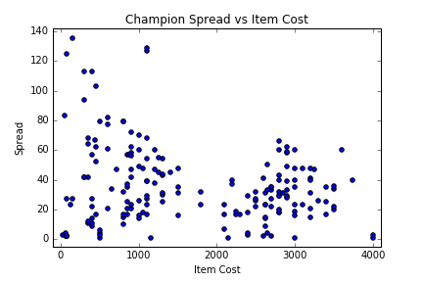
Champion Spread vs Item Cost

Slide 29
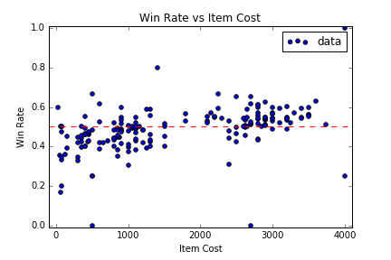
Win Rate vs Item Cost
This shows that finishing an item is good for your chances of winning

Slide 30
Aggregate by Item Tags
Items can be grouped into sets based on the bonuses they give
Example tags:
Damage
SpellDamage
Health
Armor
SpellBlock
AttackSpeed

Slide 31
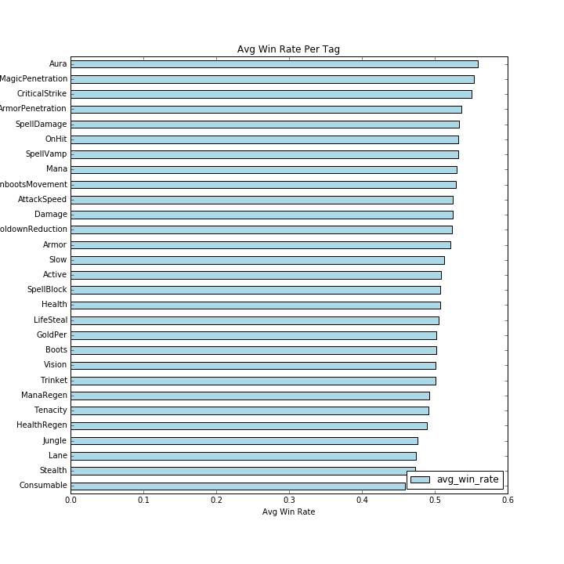
Win Rate Per Tag

Slide 32
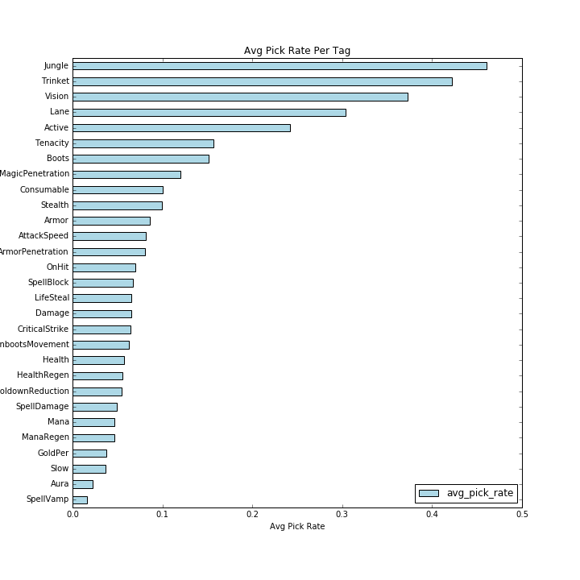
Pick Rate vs Tag

Slide 33
Purchase Timing

Slide 34
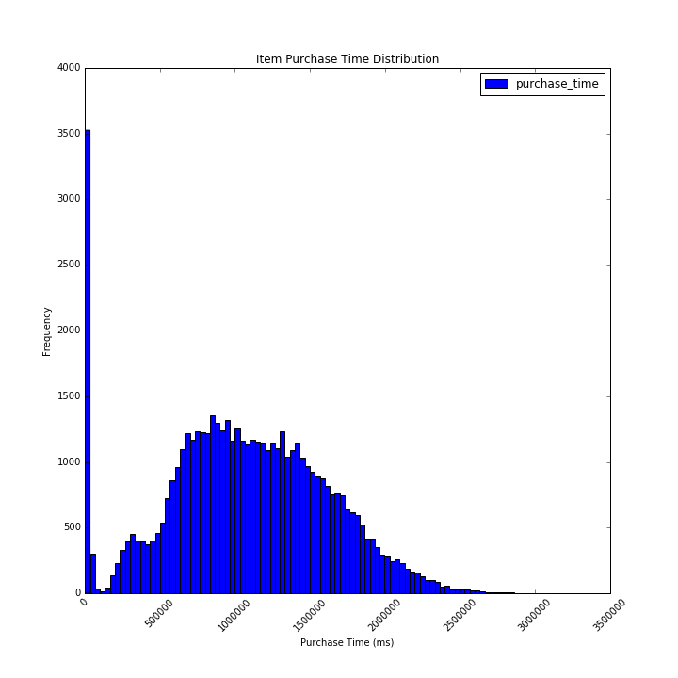
Item Purchase Time
This is for all the items that a player ends the game with.

Slide 35
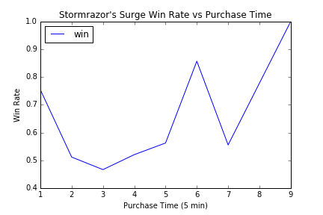
Example Item: Stormrazor’s Surge

